Slide 1
COLLEGE BUS TRACKING & NOTIFICATION SYSTEM Project Coordinator: Prof. Athira Prasad Project guide : Prof. Merin Sarah George
SUBMITTED BY,
AMAL BABU K
ATHIRA UNNIKRISHNAN
GOPIKA RAJU
NEERAJA PK

Slide 2
CONTENTS
Objective
Literature Survey
Block Diagram
Working
Circuit Diagram
NodeMCU
Power Supply(NodeMCU)
Power Supply(GPS)
Vibration Sensor
GPS
Neo 7M
Inter-Integrated Circuit LCD Display
Software Implementation
Android Application
Result
Advantage
Disadvantage
Challenges Faced
Budget
Future Scope

Slide 3
OBJECTIVE
To track the position of college bus.
To send broadcast messages about bus boarding time and changes in the schedule.
To send notifications to concerned authorities in case of an emergency.
To show the number of seats left in the bus.
An LCD display showing current location for people inside the bus

Slide 4
LITERATURE SURVEY
Paper 1:
Abid Khan and Ravi Mishra proposed the embedded system which is a single board system having GPS and GSM modems and RAM processor to track the vehicle.
Paper 2:
S.P. Manikandan and P. Balakrishnan proposed the real time query system for public transport service using Zigbee and RFID is suitable to passengers demand and provide information such as bus location,bus numbers and number of persons inside the bus in real time.

Slide 5
Paper 3:
Swati and Sneha Mugade proposed real time bus monitoring and passenger information system. It provides exact location using link updater and estimated arrival time at each stop at control unit and is displayed to passengers on a screen.
Present Scenario:
Student has to call Bus Administrator to know the location of the bus
Difficult for Person In-charge.
Difficult for students.

Slide 6
No system to notify students about change in bus schedule.
No accident alert system.
It is not possible to know seat availability beforehand

Slide 7
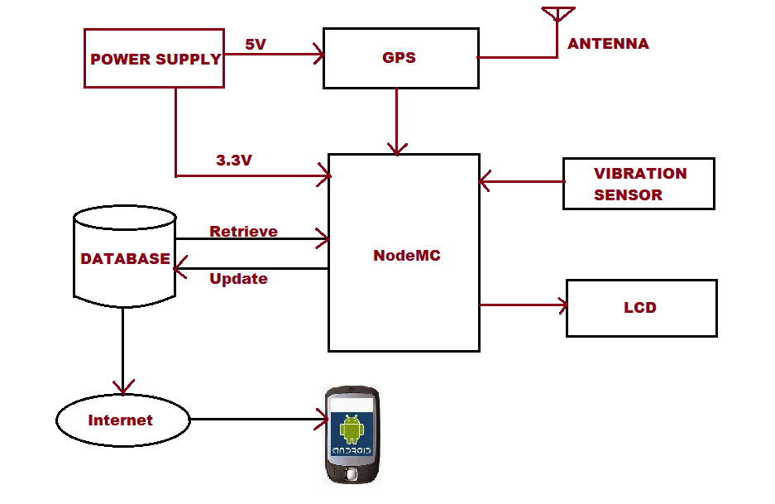
BLOCK DIAGRAM

Slide 8
WORKING
GPS Module provides geolocation(Latitude and Longitude) to NodeMC.
Coordinates are sent to database through Wifi.
Server updates location(place) with coordinates available.
Location is retrieved back to NodeMCU to display in LCD.
In case of accident vibration field in database is updated to 1.
Database is connected to internet.
Android application retrieves data from database through internet.
Application provides user interface.

Slide 9
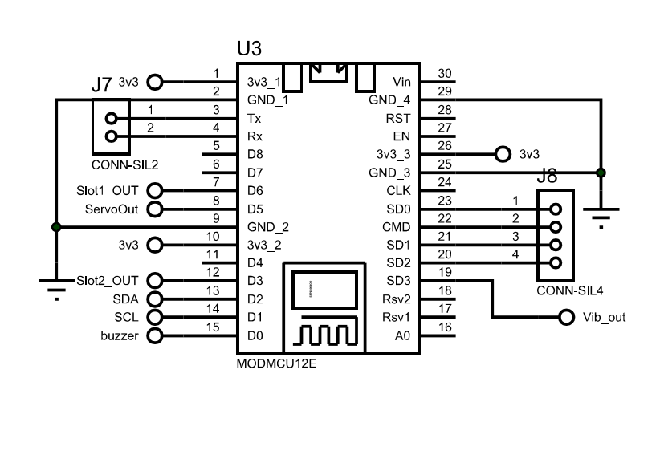

COMPONENTS: i.)NodeMCU
Open source IOT Platform.
Includes ESP 8266 Wifi SoC.
Has analog and digital pins
Supports UART,SPI, $I^{2}C$
Operates at 3.3V.

Slide 10
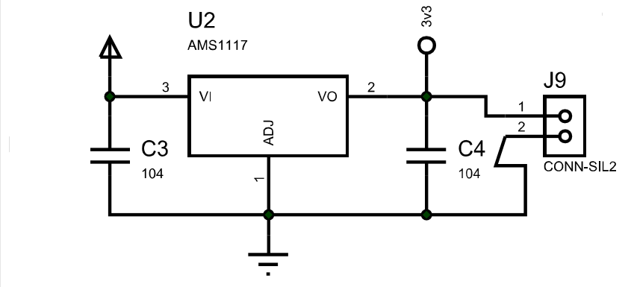
CIRCUIT DIAGRAM Power Supply
For NodeMCU(3.3V)

Slide 11
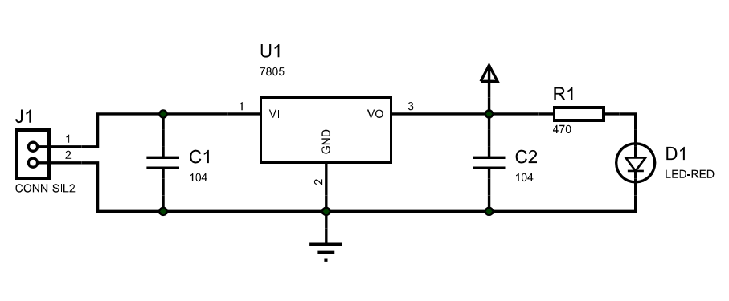
CIRCUIT DIAGRAM Power Supply
For GPS(5V)-NEO 7M

Slide 12
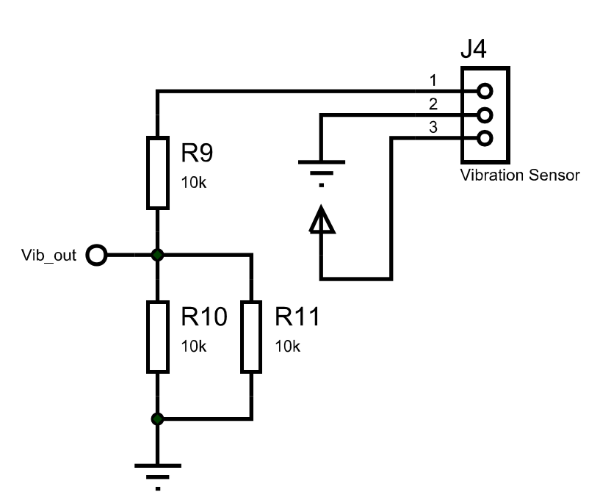
CIRCUIT DIAGRAM Vibration Sensor
Digital Sensor-When the output is 1 notifications are sent.
Vibration module consists of SW 420 Vibration sensor
and on board LM393 comparator
Supply 3.3-5V

Slide 13
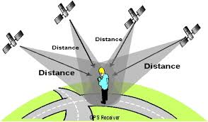
GPS Working:

Slide 14
The working/operation of Global positioning system is based on the ‘trilateration’ mathematical principle.
The position is determined from the distance measurements to satellites.
From the figure, the four satellites are used to determine the position of the receiver on the earth.
The target location is confirmed by the 4th satellite. And three satellites are used to trace the location place.

Slide 15
A fourth satellite is used to confirm the target location of each of those space vehicles.
Global positioning system consists of satellite, control station and monitor station and receiver.
The GPS receiver takes the information from the satellite and uses the method of trilateration to determine a user’s exact position.

Slide 16
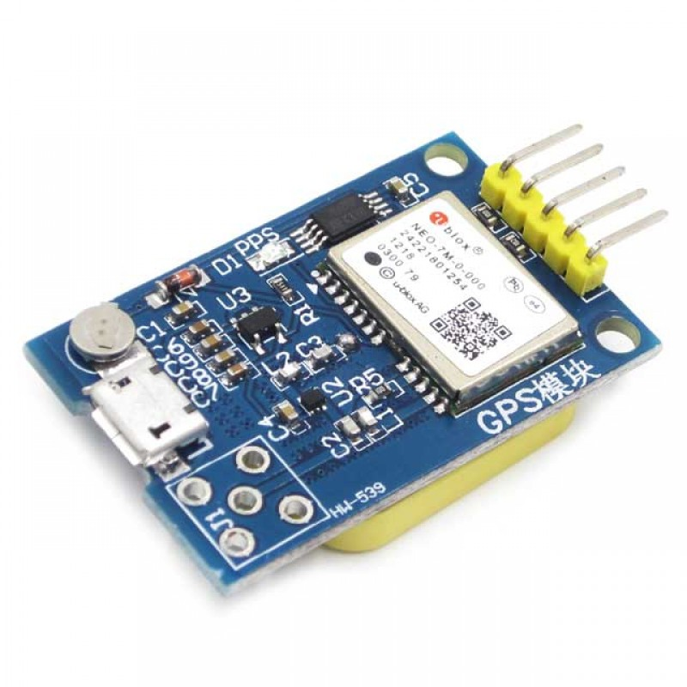
GPS NEO 7M
GPS receiver.
Power supply-5V.
Receives time and location based
information from the GPS satellite.
High Accuracy.
Baud Rate:9600
Operating Temperature:-40℃ to 85℃

Slide 17
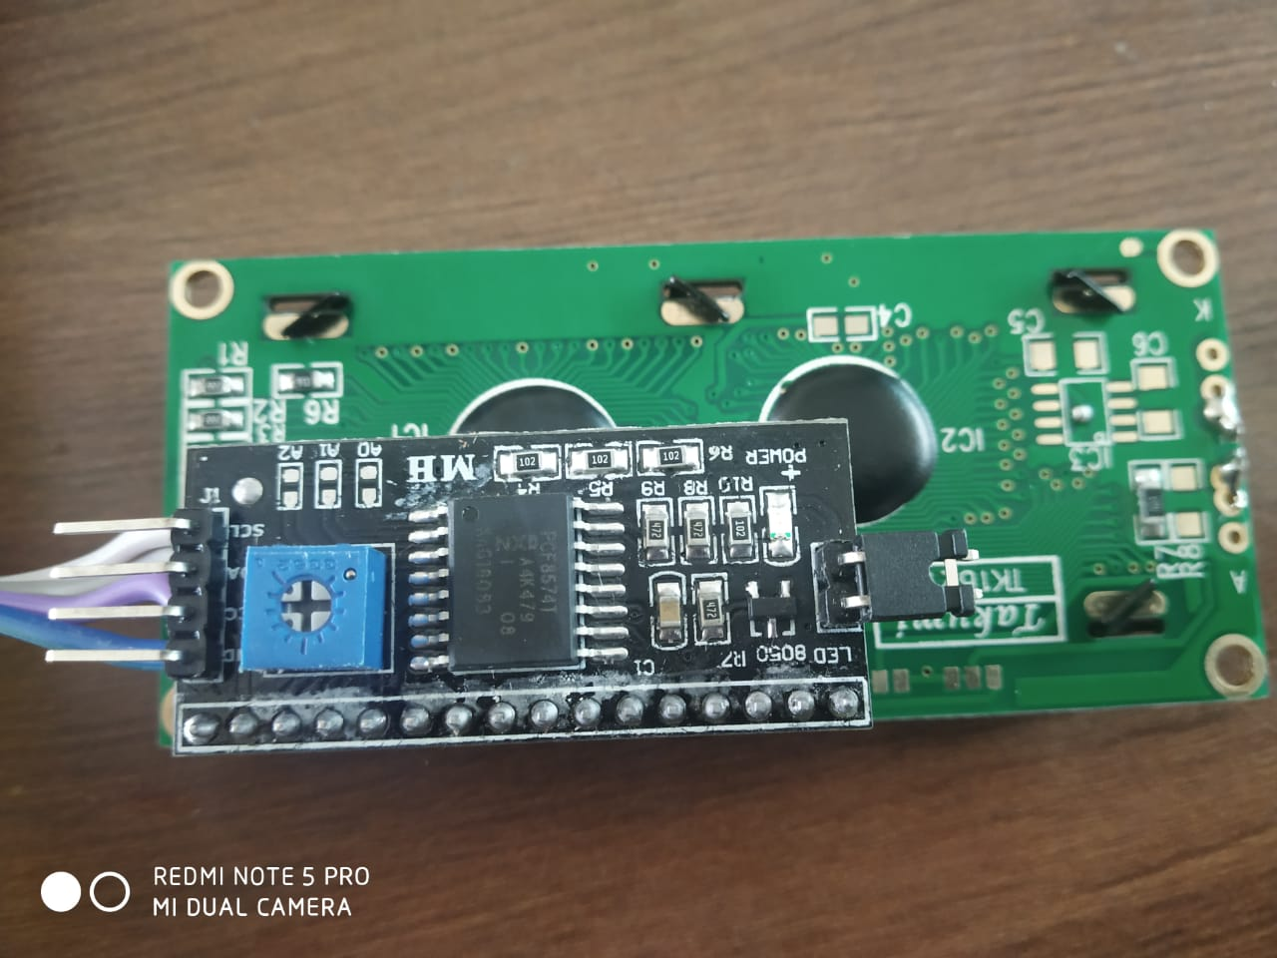
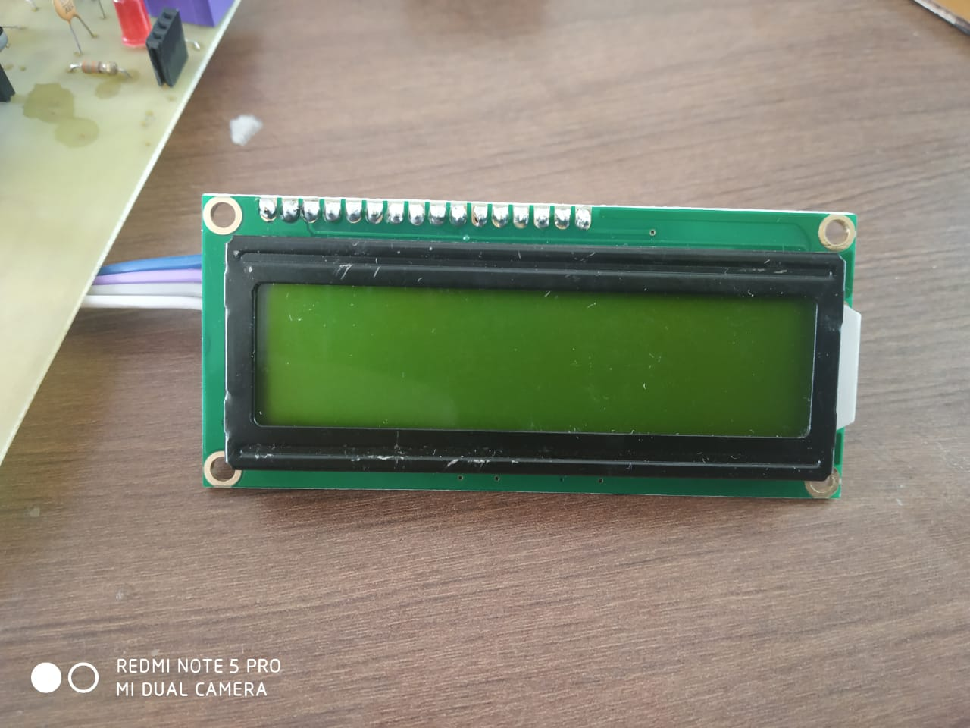
LCD Display With Inter-Integrated Circuit
Simplicity.

Slide 18
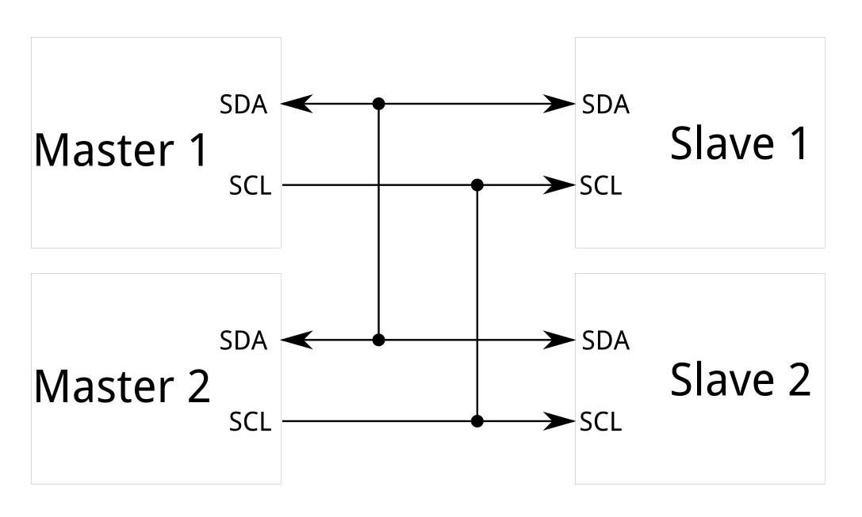
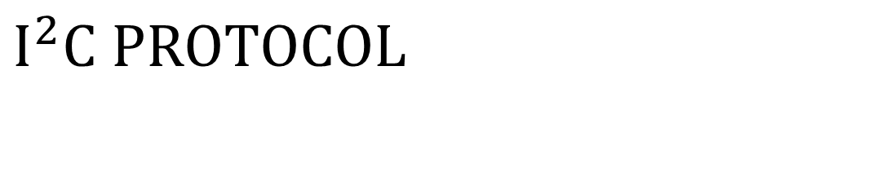
$$I^{2}C PROTOCOL$$
To establish communication between one master and multiple slaves or from many master to many slave.

Slide 19
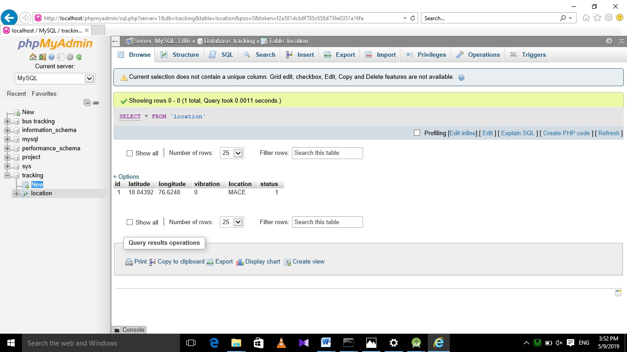
SOFTWARE IMPLEMENTATION
Database using PHP MyAdmin

Slide 20
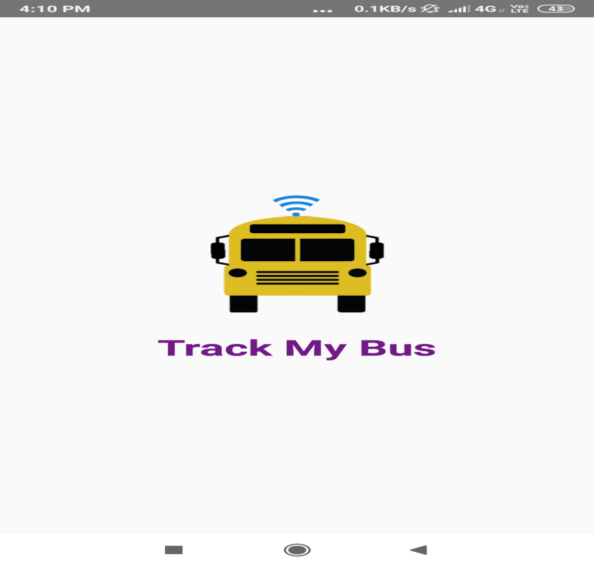
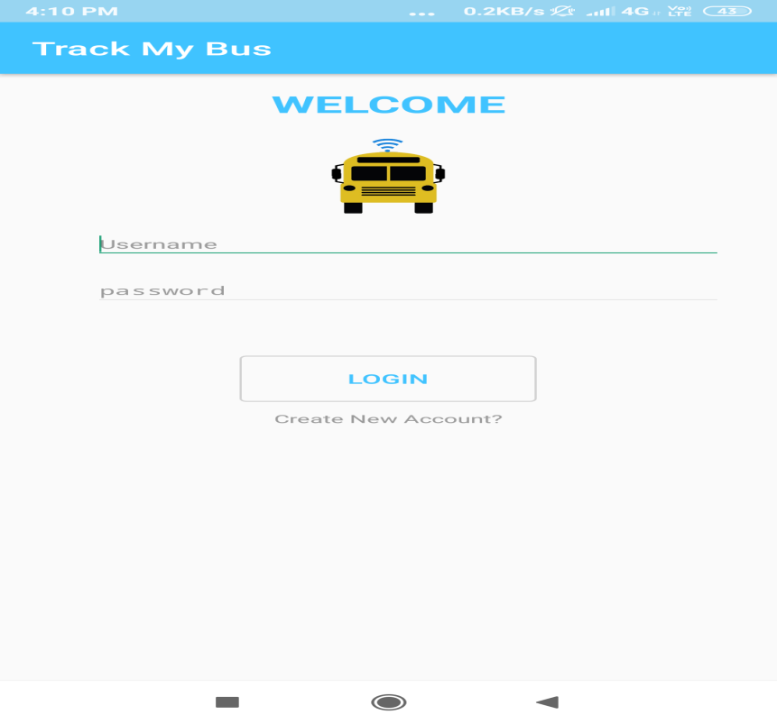
ANDROID APPLICATION
Used Android Studio(3.6) to develop the application
The app shows vehicle tracking and sending notifications in emergency.
It has a login page for security

Slide 21
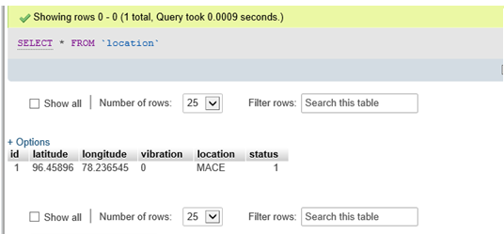
RESULT
i.)Coordinates are received in the GPS module and location is updated in the database.

Slide 22
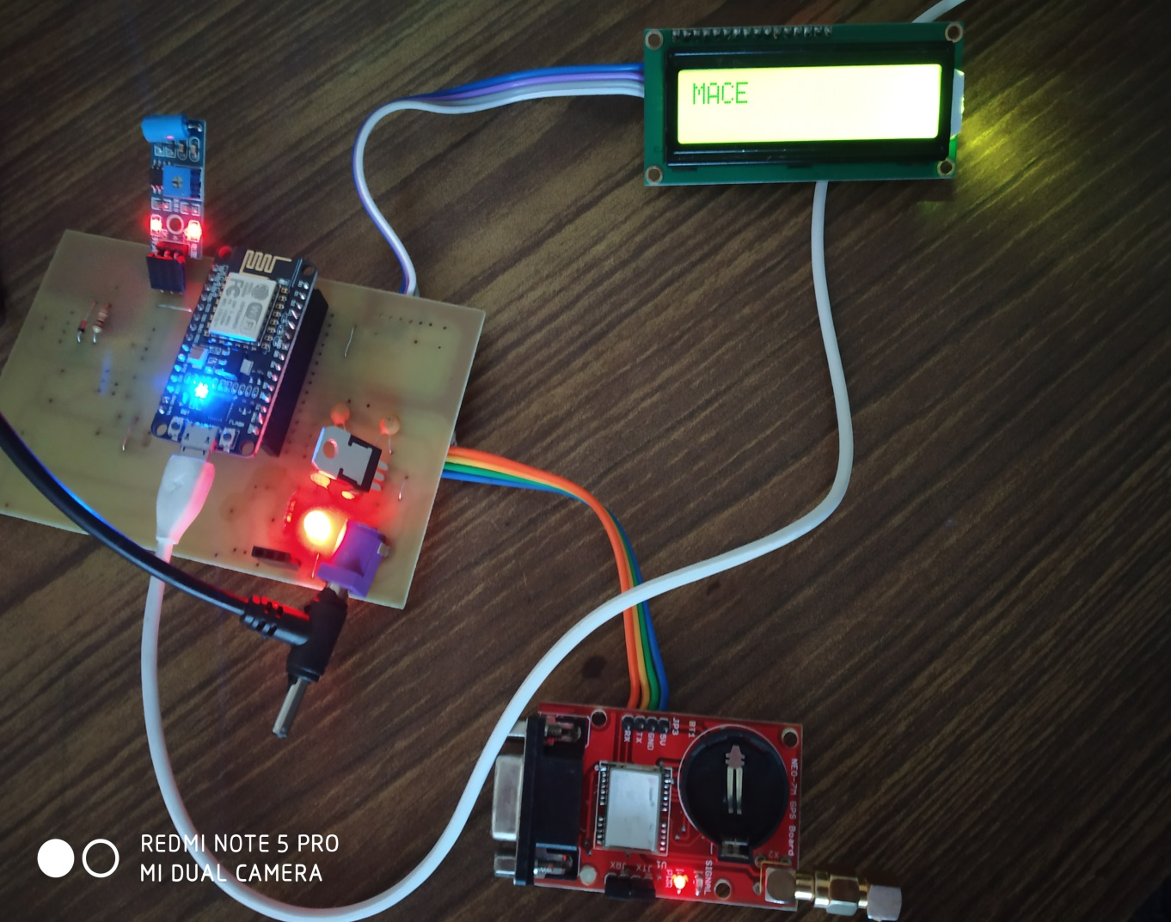
ii.)This updated location is displayed in the LCD

Slide 23
ADVANTAGES
Enables the users to catch the bus on time.
If we miss the bus in our stop we can check for the nearby bus station and its timing to arrive there accordingly.
Provides flexible bus scheduling.
Can keep track of number of students and faculty registered and travelling by bus.
Provides the management a control center to monitor the status of the bus.
Provides an aid to the management in case of emergency.

Slide 24
DISADVANTAGES
Cannot identify the seat number of the available seat.
Climatic change will affect accuracy of GPS.

Slide 25
CHALLENGES FACED
Difficulty to code in Android Studio
Burnt 1 NODMCU module
Vibration Sensor was not working
Difficulty to develop hybrid app
Changed to android app alone
Difficulty to obtain coordinates in GPS at first

Slide 26
BUDGET
NEO 7M - Rs.2000
Vibration sensor -Rs.320
NODE MCU -Rs. 650
LCD -Rs. 200
12V Adapter -Rs. 120
AM1117 -Rs. 10
7805 IC -Rs. 12.50
Resistor (470Ω)(1) -Rs.3
Capacitor(140pF) -Rs.7
TOTAL COST: Rs. 3322.5/-

Slide 27
FUTURE SCOPE
Extent Android application to Hybrid application for both Android as well as IOS users.
It can be combined with databases of other group to find seat availibilit y.
Can be extended to any institutions, industries, companies to know the current status of the buses
The project will be put up on a cloud platform so that it is accessible to every android user

Slide 28

Thank you

